Slide 1
CBS1A01P Fun with Language
Lecture 11
語言接觸 language contact

Slide 2
社會語言學 sociolinguistics
研究語言與社會
studies language and society
研究語言在社會不同場合、不同群體之使用
studies how language is used in different social situations and how language varieties differ between social groups
研究社會不同情況如何影響語言之使用
studies the effect of the aspects of society on how language is used

Slide 3
本課題目
語言接觸 language contact
(1) 通用語 lingua francas
(2) 混雜語言 / 皮欽語 pidgins
例：Chinese Pidgin English (CPE) 洋涇濱英語
(3) 克里奧爾語 / 歸融話 creoles
例：Tok Pisin 巴布亞皮欽語/托克皮辛語
(4) 借詞 lexical borrowing
(5) 語碼轉換 code-switching

Slide 4
本課題目
語言接觸 language contact
(1) 通用語 lingua francas
(2) 混雜語言 / 皮欽語 pidgins
例：Chinese Pidgin English (CPE) 洋涇濱英語
(3) 克里奧爾語 / 歸融話 creoles
例：Tok Pisin 巴布亞皮欽語/托克皮辛語
(4) 借詞 lexical borrowing
(5) 語碼轉換 code-switching

Slide 5
Lingua francas 通用語
說不同語言的人，為了溝通便利，選擇用來作為社交、商貿溝通用途的語言
lingua franca: UNESCO (1953) “a language which is used habitually by people whose mother languages are different in order to facilitate communication between them”

Slide 6
Lingua francas 通用語
中世紀時期，有一叫做Lingua Franca的通商語言 (trade language) 在地中海港口 (the Mediterranean ports ) 廣泛使用
此語言是一種混雜語言 pidgin (由法語、意大利語等語言混合而成)

Slide 7
Lingua francas 通用語
現今和過去的通用語 examples of past and present lingua francas
French 法語: 以前是 外交通用語 diplomatic lingua franca
English 英語: 「世界通用語」“the lingua franca of the whole world”; the lingua franca of international Air Traffic Control

Slide 8
Lingua francas 通用語
現今和過去的通用語 examples of past and present lingua francas
Latin 拉丁語: was a lingua franca of the Roman Empire and of western Christendom 西方基督教 for a millennium
Greek 希臘語: was a lingua franca of the eastern Christendom 東方基督教

Slide 9
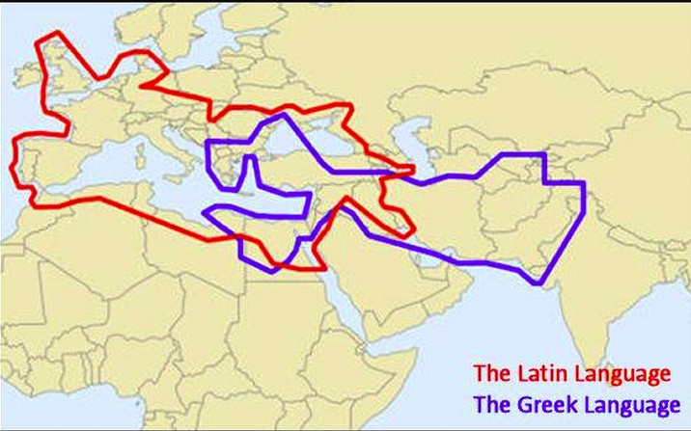
Lingua francas 通用語
Latin and Greek as lingua francas

Slide 10
Putonghua 普通話
Standard Chinese / Standard Mandarin
(1) phonology: based on the Beijing dialect
語音：以北京語音為標準音
(2) vocabulary: drawn from the Chinese dialects spoken across northern, central and southwestern China (the varieties are called Mandarin Chinese)
詞匯：以北方話為基礎

Slide 11
Putonghua 普通話
(3) grammar: standardized to the body of modern literary works that define written vernacular Chinese (originally Baihua)
語法：以典範的現代白話文著作為語法規範
從以上例子看到，通用語：
可以是因為商貿需要等而自然產生
也可能是政府設立的

Slide 12
本課題目
語言接觸 language contact
(1) 通用語 lingua francas
(2) 混雜語言 / 皮欽語 pidgins
例：Chinese Pidgin English (CPE) 洋涇濱英語
(3) 克里奧爾語 / 歸融話 creoles
例：Tok Pisin 巴布亞皮欽語/托克皮辛語
(4) 借詞 lexical borrowing
(5) 語碼轉換 code-switching

Slide 13
Pidgins 混雜語言 / 皮欽語
兩種（或以上）語言混合
介於兩種（或以上）語言之間，兼有這些語言的語法特點
Pidgin: “a contact vernacular, normally not the native language of any of its speakers… it is characterized by a limited vocabulary, an elimination of many grammatical devices such as number, gender, and a drastic reduction of redundant features.” (DeCamp, 1971) DeCamp, D. (1971). The study of pidgin and Creole languages. In D. Hymes (Ed.), Pidginization and Creolization of Languages: Proceedings of a Conference Held at the University of the West Indies, Mona, Jamaica, April 1968. London: Cambridge University Press. pp. 13-43.
口語

Slide 14
Pidgins 混雜語言 / 皮欽語
the term “pidgin” first appeared in print in 1850s
etymology uncertain 這詞的起源不確定:
English business? and/or Cantonese 畀錢 bei2 cin2 'pay money'?
That belong he pidgin "That's his business" (Chinese Pidgin English)

Slide 15
Pidgins 混雜語言 / 皮欽語
結構簡單，但有語法規律 (simple but rule-governed)
詞語不多，語法較簡化 (few lexical items and less complex grammatical rules)
一般來說，其中一個語言提供pidgin中大部分的詞語（這語言稱為 the lexifier language）

Slide 16
Pidgins 混雜語言 / 皮欽語
Why did pidgins arise?
prolonged and regular contact between the different language communities who had the need to communicate
an absence of a widespread and accessible lingua franca

Slide 17
Pidgins 混雜語言 / 皮欽語
during the 17th, 18th and 19th centuries, many pidgins came into existence along the coasts of China, Africa, and the Americas to accommodate the Europeans

Slide 18
Chinese Pidgin English (CPE)
洋涇濱英語
18th century: trade in Macau and Guangzhou
teaching of Chinese to foreigners was forbidden
compradores 買辦 (葡語 “buyers”) 負責翻譯
Pidgin English developed with Portuguese influence (savee “know”)

Slide 19
Chinese Pidgin English (CPE)
19th century: European settlements in south China
the first treaty ports:
Hong Kong 香港, Guangzhou (Canton) 廣州, Xiamen (Amoy) 廈門, Fuzhou 福州, Ningbo 寧波, Shanghai 上海
Chinese Pidgin English developed

Slide 20
Chinese Pidgin English (CPE)
書面記錄，包括歌詞本、書信、回憶錄、航海記錄等
例子：
Ping-Wing he look-see, tinkey fun
Two piecee man who shleep in sun Leland, C.G. (1876). Pidgin-English Sing-Song. London: Trϋbner & Co., p. 29. http://archive.org/details/pidginenglishsin00lelaiala

Slide 21
Chinese Pidgin English (CPE)
例子：
Olom man talkey, 'No can walk!' By'mby rain come--welly dark Have got water, welly vide. Maskee! My wantchey go topside Topside-galow! cited in Elder, C. (1999). China's Treaty Ports: Half Love and Half Hate. Hong Kong: Oxford University Press.

Slide 22
Chinese Pidgin English (CPE)
The Guangzhou Pidgin Phrasebook: The Common Language of the Red-haired Foreigners (c. 1850) 《紅毛通用番話》
using Cantonese characters to indicate English pronunciation:
‘1’ = 溫 ‘10’ = 癲 ‘me’ = 米

Slide 23
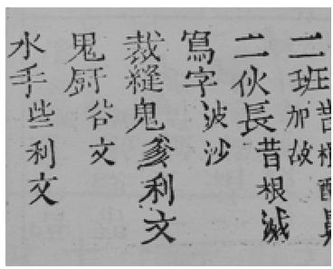
Chinese Pidgin English (CPE)
《紅毛通用番話》
大家有見過「通書」/「通勝」中相似的標音法嗎？

Slide 24
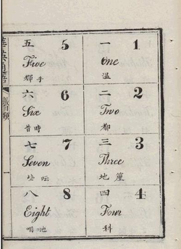
Chinese Pidgin English (CPE)
the earliest English textbook authored by Chinese was Chinese-English Communicative Practice 《華英通語》 published in 1860
also using Cantonese characters to indicate English pronunciation

Slide 25
Chinese Pidgin English (CPE)
The Chinese and English Instructor 《英語集全》by King-sing Tong 唐廷樞 (唐景星) (1862); published in 6 volumes
a phrase book using Chinese characters to represent English
additional entries in margins give pidgin equivalents in Guangdong faan waa (Canton pidgin)

Slide 26
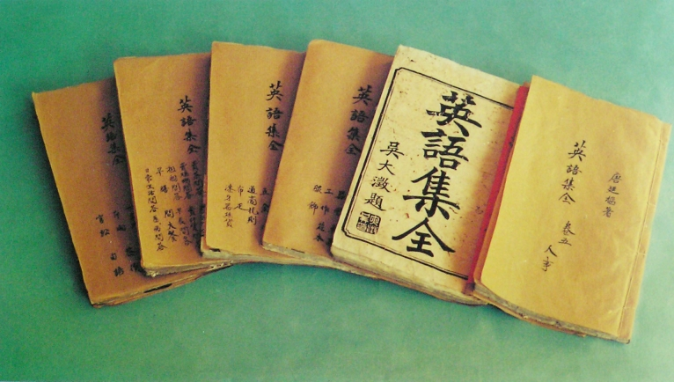
Chinese Pidgin English (CPE)
The Chinese and English Instructor 《英語集全》

Slide 27
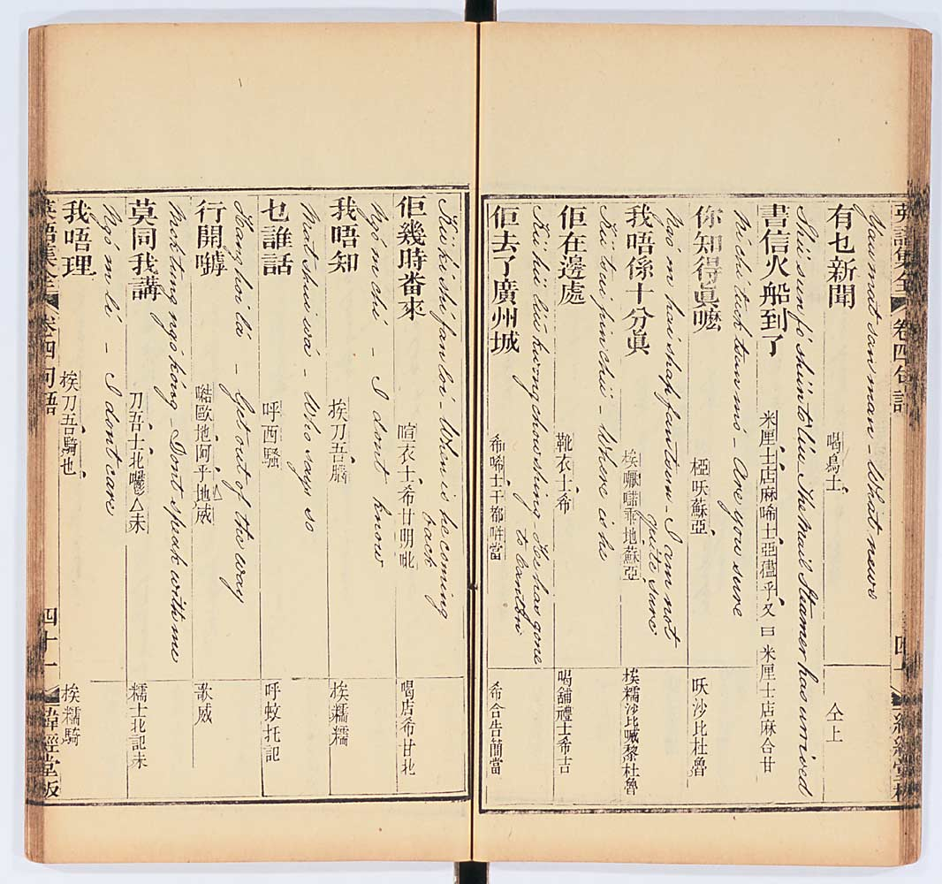
Chinese Pidgin English (CPE)
The Chinese and English Instructor 《英語集全》

Slide 28
Chinese Pidgin English (CPE)
watch a clip produced by Childhood Bilingualism Research Centre, Department of Linguistics & Modern Languages, CUHK http://www.youtube.com/watch?v=YieVSrzRqRo
the Chinese Pidgin English dialogue is from Bauer (1974, p. 154) and cited in Sebba (1997, p.68) Bauer, A. (1974). Das melanesische und chinesische Pidginenglisch: linguistische Kriterien und Probleme. Regensburg: Hans Carl. Sebba, M. (1997). Contact Languages: Pidgins and Creoles. London: Macmillan.

Slide 29
Chinese Pidgin English (CPE)
examples of the structure of CPE:
lack of verb inflection: whafo no have see taipan sot langim?
using have/hab as an auxiliary: have bring rice this voyage?
conditional sentences with suppose: spose likee can do

Slide 30
Chinese Pidgin English (CPE)
examples of the structure of CPE:
no distinction between voiced and voiceless consonants, e.g., din "ten"
CV(C) syllable structure, avoiding consonant clusters, e.g.,
popa ledda = “proper leather"
no v, r or th sounds
belly = very dat = that tinkee = think

Slide 31
Chinese Pidgin English (CPE)
examples of the structure of CPE:
preverbal negation: no can maykee
classifiers: one piece wifoo “a wife”
Placement of time adverbs: he every day tipsy “He gets drunk every day”

Slide 32
Chinese Pidgin English (CPE)
20th century: decline of CPE
Chinese and missionary schools began teaching Standard English
foreign settlements in mainland China disbanded after 1949

Slide 33
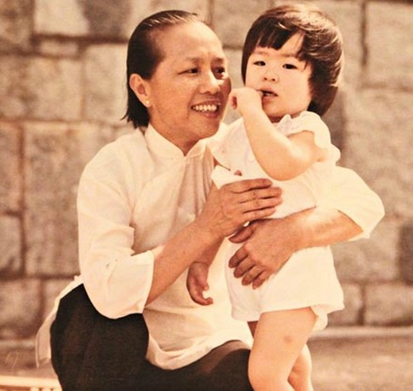
Chinese Pidgin English (CPE)
pidgin was probably last spoken in Hong Kong by Chinese “black and white amahs” and cooks in 1960s-1970s

Slide 34
本課題目
語言接觸 language contact
(1) 通用語 lingua francas
(2) 混雜語言 / 皮欽語 pidgins
例：Chinese Pidgin English (CPE) 洋涇濱英語
(3) 克里奧爾語 / 歸融話 creoles
例：Tok Pisin 巴布亞皮欽語/托克皮辛語
(4) 借詞 lexical borrowing
(5) 語碼轉換 code-switching

Slide 35
Creoles 克里奧爾語 / 歸融話
A creole is a language that began as a pidgin and eventually becomes the first language of a speech community through its being learned by children. 混雜語成了一些人的母語
an example: Tok Pisin in Papua New Guinea

Slide 36
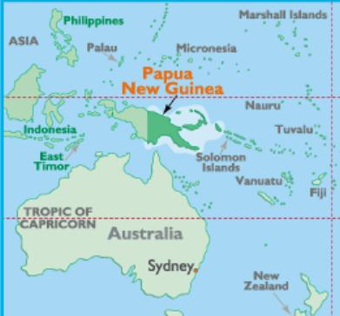
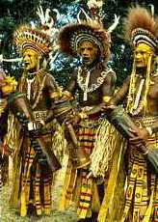
Tok Pisin
an English-based creole widely used in Papua New Guinea (one of the three official languages)
Tok from English “talk”, also means “word”, “speech”, “language”; Pisin English “pidgin”

Slide 37
Tok Pisin
Tok Pisin; evolved from Melanesian Pidgin English, once a widely spoken lingua franca of Papua New Guinea
English-based pidgins developed in the 19th century for use between English-speaking traders and the native population
since New Guinea is very linguistically diverse, the pidgin also came to be used as a lingua franca among the indigenous population
Tok Pisin was gradually creolized throughout the 20th century

Slide 38
Tok Pisin
Prince Charles in Papua New Guinea.
http://www.youtube.com/watch?v=YU9rVcSEnkw
Tok Pisin:
"Mi bringim bikpela tok hamamas bilong mejesti kwin Papua Niugini na olgeta haus lain bilong mi lon dispela taim bilong Diamon Jubili misis kwin. Mi tokpisin olrite?“
translation:
"I bring you greetings from Her Majesty the Queen of Papua New Guinea and from all my family members during this celebration of the Diamond Jubilee of the Queen. Was my Pisin correct?

Slide 39
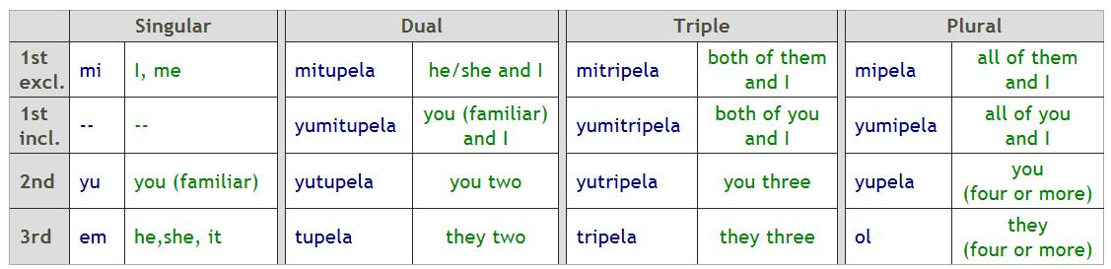
Tok Pisin
the phonology 語音系統 is simple:
consonants: p b t d k ɡ v s h m n ŋ l w j r
vowels: i u e o a
but some features may be complex, e.g., the pronoun system
pronouns
http://www.unilang.org/course.php?res=80#ci-l2personalpronouns

Slide 40
Creolization
A creole is far richer and more complex than the pidgin that the children heard when growing up
How are children able to construct a creole based on the rudimentary input of the pidgin?
The pidgin is reanalyzed by the children, whose innate grammatical abilities immensely enrich it, and so it becomes a full-fledged language.

Slide 41
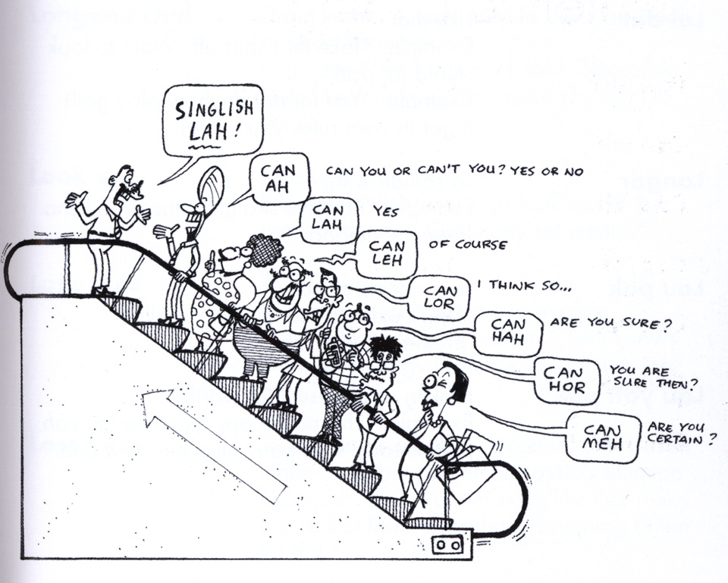
Singlish
Colloquial Singaporean English
an English-based creole
having influences from Hokkien, Cantonese, Teochow, Malay, Indian
Singapore: independence from the Federation of Malaysia in 1965; active promotion of the use of English

Slide 42
本課題目
語言接觸 language contact
(1) 通用語 lingua francas
(2) 混雜語言 / 皮欽語 pidgins
例：Chinese Pidgin English (CPE) 洋涇濱英語
(3) 克里奧爾語 / 歸融話 creoles
例：Tok Pisin 巴布亞皮欽語/托克皮辛語
(4) 借詞 lexical borrowing
(5) 語碼轉換 code-switching

Slide 43
借詞 lexical borrowing
語言中的詞匯是一個動態的開放性系統，不斷吸收外來詞是語言豐富和發展的途徑之一。

Slide 44
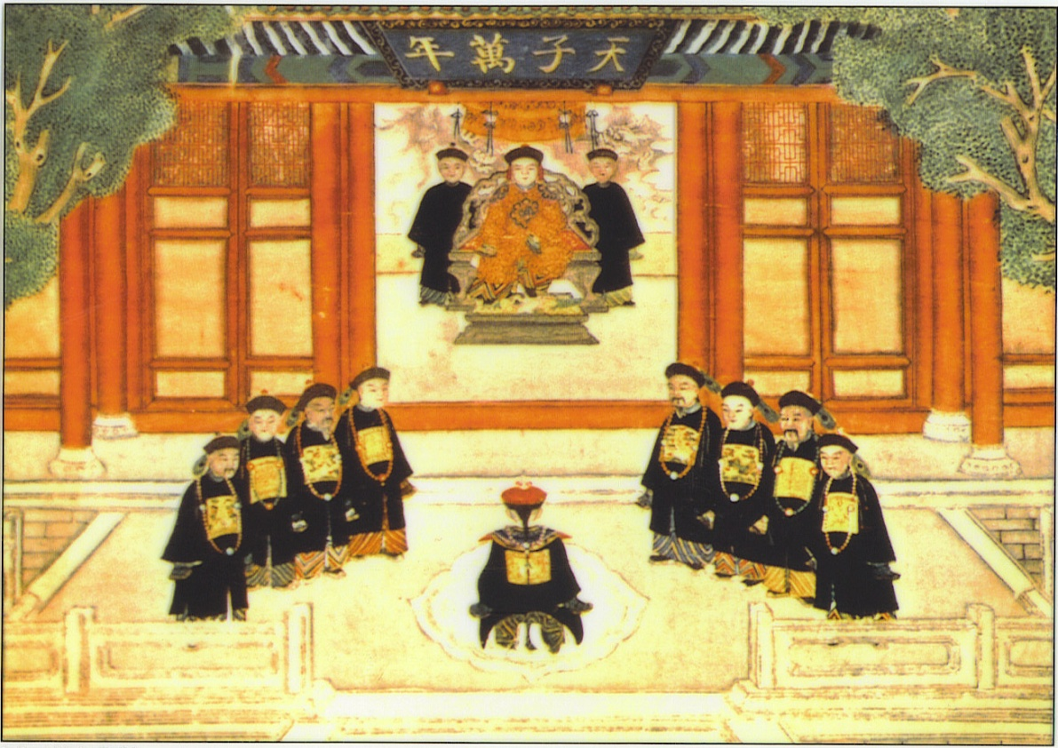
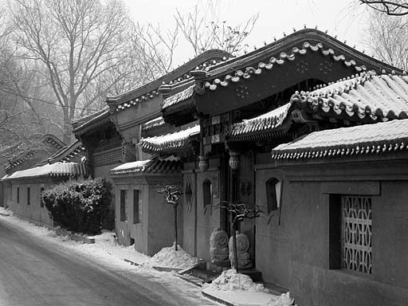
英語吸收漢語借詞的方式
1. 音譯法 transliteration
用英語拼音文字按照漢語借詞原來的讀音譯成的借詞。如氣功、陰、陽、胡同、叩頭等。

Slide 45
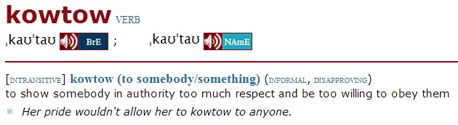
英語吸收漢語借詞的方式
氣功 qigong
陰 yin
陽 yang
胡同 hutong
叩頭 kowtow

Slide 46
英語吸收漢語借詞的方式
1. 音譯法
有的音譯借詞初借時是按威式拼音拼寫的，
如 T’ai chi (太極)、Litchi (荔枝) 等。
威妥瑪式拼音法（Wade-Giles Romanization）， 簡稱威式拼音法。中國清末至1958年中文拼音方案公佈前，中國和國際上流行的中文拼音方案。
威式拼音法被普遍用來拼寫中國的人名、地名等。
Mao Tse-tung (Mao Zedong) Lao Tzu (Lao Zi)
Canton (Guangzhou) Peking (Beijing)

Slide 47
英語吸收漢語借詞的方式
1. 音譯法
有些音譯借詞是根據漢語方言的讀音拼寫出來的，如 choy sum
feng-shui /ˌfeŋ ˈʃuːi/ /ˌfʊŋ ˈʃweɪ/
sampan /ˈsæmpæn/
mahjong /mɑːˈdʒɒŋ/
cheongsam /tʃɒŋˈsæm/

Slide 48

英語吸收漢語借詞的方式
1. 音譯法
choy sum 菜心
feng-shui 風水
sampan 舢舨
mahjong 麻將
cheongsam 長衫

Slide 49
英語吸收漢語借詞的方式
Cheongsam
Oxford Advanced Learner’s Dictionary
(from Chinese)
a straight, tightly fitting silk dress with a high neck and short sleeves and an opening at the bottom on each side, worn by women from China and Indonesia

Slide 50
英語吸收漢語借詞的方式
2. 意譯法
保持漢語的內容，按照其字面意思直接翻譯成一個新詞，意譯出來的詞在英語中大多以短語形式出現。
如 winter melon, gang of four 等。

Slide 51
英語吸收漢語借詞的方式
3. 合成法
在事物名稱或概念前加上 China、Chinese、Sino等描寫成分，再和英語中已有的詞構成複合詞，如 Chinese costume、Chinese dragon。
這種複合外來詞還包括半音半意構成的借詞，如Peking Man、taikonaut 。

Slide 52
英語吸收漢語借詞的方式
Chinese costume (唐裝)
Chinese dragon (龍)
Peking Man (北京猿人)
taikonaut (中國宇航員)
中國宇航員（由中文拼音 taikong 太空 和 astronaut 縮合而成）: Oxford English Dictionary中解釋為“A Chinese astronaut” http://www.oed.com/view/Entry/268504?redirectedFrom=taikonaut#eid

Slide 53
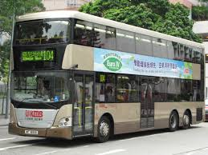
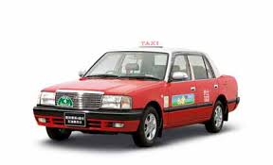
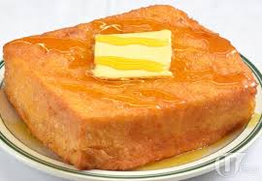
漢語吸收英語借詞的方式
1. 音譯法 transliteration
按照英語原詞的讀音譯成借詞， 如巴士 (bus)、的士 (taxi)、多士 (toast)

Slide 54


漢語吸收英語借詞的方式
2. 半音半意譯法
把外來詞一分為二，一半採用音譯，一半採用意譯，如:蛋撻 (egg tart), 呼拉圈 (hula-hoop) 等。

Slide 55
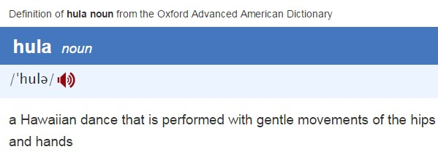
hula
夏威夷草裙舞（呼拉舞）

Slide 56
漢語吸收英語借詞的方式
3. 音譯加漢語表意語素
為了使借詞能更清楚地表達原詞的意義，先音譯其詞，再加上表示類屬、特徵的漢語語素。
如 ballet、 sauna、AIDS
芭蕾舞
桑拿浴
愛滋病

Slide 57
漢語吸收英語借詞的方式
4. 音意兼譯
兼顧外來詞的讀音和詞義，用接近原詞特點但又非原詞詞義的漢字進行改寫，做到「音意合璧」。

Slide 58
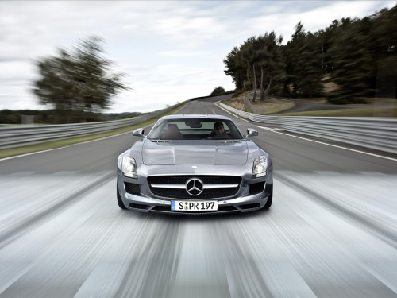

漢語吸收英語借詞的方式
4. 音意兼譯
奔馳/賓士 (Benz)、奔騰 (Pentium) 等給人一種快捷、高效的感覺。

Slide 59
漢語吸收英語借詞的方式
5. 意譯法
按照英語外來詞的形態結構和構成原理直接翻譯成漢語借詞。
如跳蚤市場 (flea market)、綠色環保標誌 (green logo)、試管嬰兒 (test- tube baby)、等。

Slide 60
漢語吸收英語借詞的方式
6. 原文移植法
許多英語詞直接以英語的形式或英漢夾雜的形式出現在漢語中，以避免音譯或意譯繁瑣的不足。這首先包括在新聞和科技語體中運用的大量縮略語和簡稱 。

Slide 61
漢語吸收英語借詞的方式
例：“設置頭像的聯絡人僅支援存儲在手機中的聯絡人，若您的聯絡人存儲在SIM卡中，請先將聯絡人複製到手機中再進行上述操作。”
你知道SIM的全寫嗎？
SIM (專用資料卡 subscriber identification module)

Slide 62
本課題目
語言接觸 language contact
(1) 通用語 lingua francas
(2) 混雜語言 / 皮欽語 pidgins
例：Chinese Pidgin English (CPE) 洋涇濱英語
(3) 克里奧爾語 / 歸融話 creoles
例：Tok Pisin 巴布亞皮欽語/托克皮辛語
(4) 借詞 lexical borrowing
(5) 語碼轉換 code-switching

Slide 63
Code-switching and code-mixing
code-switching 語碼轉換; code-mixing 語碼混合
note that these two terms are often used interchangeably
code-switching: switching between two or more languages or language varieties in the context of a single conversation
sometimes, “code-mixing” is used specifically to refer to intrasentential (句內) code-switching

Slide 64
Code-switching vs. Borrowing
code-switches: used by bilingual speakers only
borrowings: by contrast, regularly used by monolinguals

